Slide 1

UE Swimming & Diving Scheduling and Performance Platform
Michael Pruett — CS 495 Senior Project

Slide 2
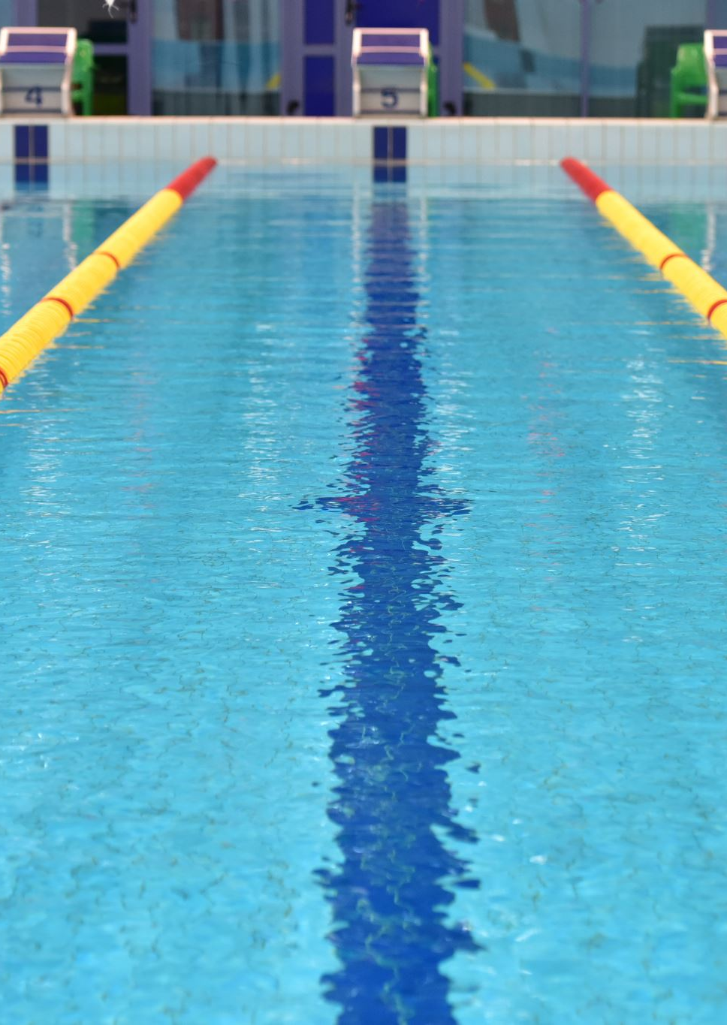
Overview
Client: UE Swimming & Diving coaching staff
Users: Coaches and swimmers
Goal: Combine scheduling and swimming-performance information into one platform

Slide 3
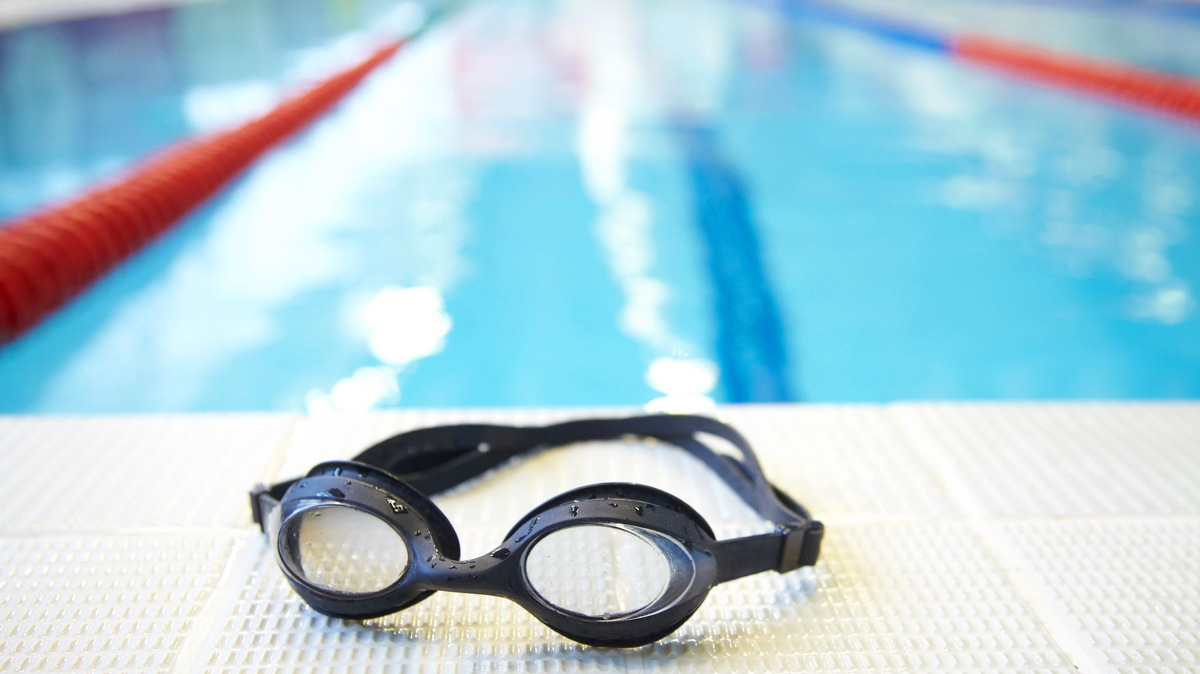
Current Prototype / Core Functionality
Coach and Swimmer prototype views
20 fictional swimmer schedules
Practice conflict detection
Configurable transition time between class and practice
Automatic ranking of practice windows
Weekly team calendar
Roster and individual schedules
Swimming performance tracking and progression

Slide 4
Successes
Working React/Vite frontend
Python/FastAPI backend
Frontend and backend successfully connected
Conflict/ranking logic tested
Monday–Sunday scheduling support
Responsive, more polished interface
Mock data keeps prototype development privacy-safe

Slide 5
Challenges / Limitations
Prototype currently uses mock data
No database yet
Role selection is not real authentication
Current ranking checks predefined practice windows
Calendar is a mock week rather than a live dated calendar
Need to continue balancing useful features with project scope

Slide 6
Next Steps
Immediate
Generate and rank practice windows automatically using coach constraints
Replace simple progression lists with performance graphs
Begin relational database implementation
Later
Goals and practice tracking
Authentication / real permissions
Approved data imports
Deployment and usability testing

